Slide 1
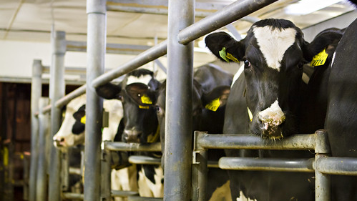
DAIRY MANAGEMENT SYSTEM
Nitin kumar and Rashu malik
This Photo by Unknown Author is licensed under CC BY-NC

Slide 2
INTRODUCTION
We are creating a Window application for “Dairy management system”.
In C++ language by using Code block & Dev C++. The mission of the Milk Production House Project is to create to communication between rural area people and dairy management. Our goal is to develop this application to encourage our dairy industry. Dairy milk management system is a software application to maintain day to day transactions in a Milk dairy. This software helps to register all the suppliers, Buyer details, purchase, Sales details. Our plan is to collect the Milk from many different sources and distribute the same to the Milk buyers.

Slide 3


Objectives:
To develop a Dairy Management System for managing daily dairy operations.
To maintain records of milk purchase, sales, suppliers, and customers.
To reduce manual work and human errors through automation.
To generate bills and maintain transaction records efficiently.
To improve the overall efficiency and management of dairy businesses.

Slide 4


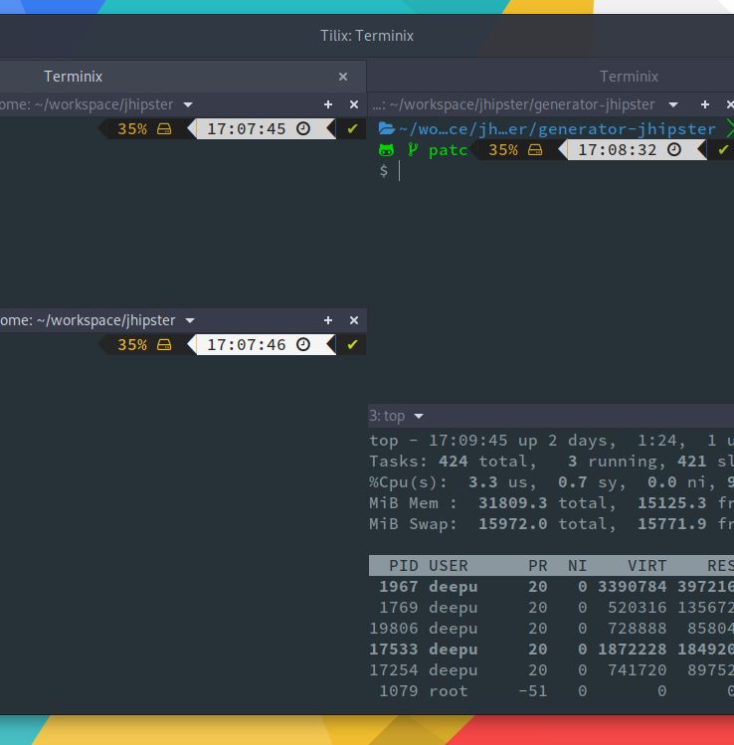
SOFTWARE REQUIREMENTS SPECIFICATION
The Grocery Management System can run on multiple operating systems, including: • Windows 10/11 – Commonly used for development and deployment. • Linux (Ubuntu, Fedora, etc.) – Preferred for server-based applications. • macOS – Used by developers who prefer Mac for C++ programming.
1. Operating System (OS)
• C++ (Standard C++17 or later) is the core language used for developing the system. • It provides high performance and efficient memory management, making it suitable for real-time applications.
2. Programming Language
To write, compile, and debug C++ code, the following IDEs can be used: • Code::Blocks – Lightweight and easy to use. • Dev-C++ – Suitable for beginners. • Microsoft Visual Studio – Best for large-scale projects with GUI. • Qt Creator – Ideal for GUI-based applications using the Qt framework.
3. Integrated Development Environment (IDE)

Slide 5

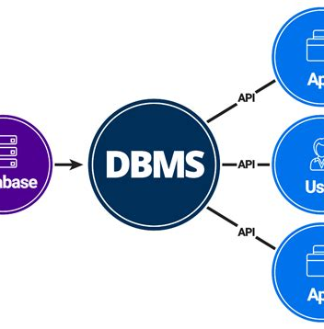
SOFTWARE REQUIREMENTS SPECIFICATION
GCC (GNU Compiler Collection) – Used in Linux/macOS environments. MinGW (Minimalist GNU for Windows) – Commonly used for Windows development. MSVC (Microsoft Visual C++ Compiler) – Comes with Visual Studio.
4. Compiler
5. Database Management System (DBMS)
A database isrequired to store product details, customer data, and sales records. Some commonly used databases are: MySQL – Recommended for large-scale data handling. SQLite – Lightweight, file-based database suitable for small businesses. PostgreSQL – Advanced database with strong security features. Libraries and Frameworks Qt Framework – Used for building a graphical user interface (GUI). MySQL Connector for C++ – Allows integration with MySQL databases. Boost Library – Provides additional C++ functionalities. OpenCV (Optional) – Can be used for barcode scanning or facial recognition. Additional Software XAMPP – A server environment for running MySQL databases locally. Git – Used for version control and collaborative development.

Slide 6

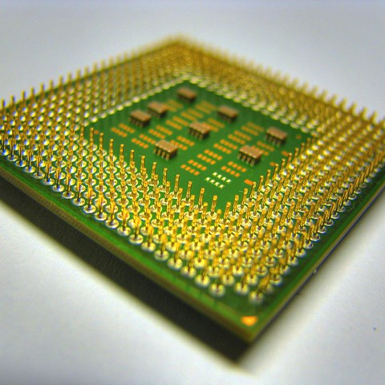
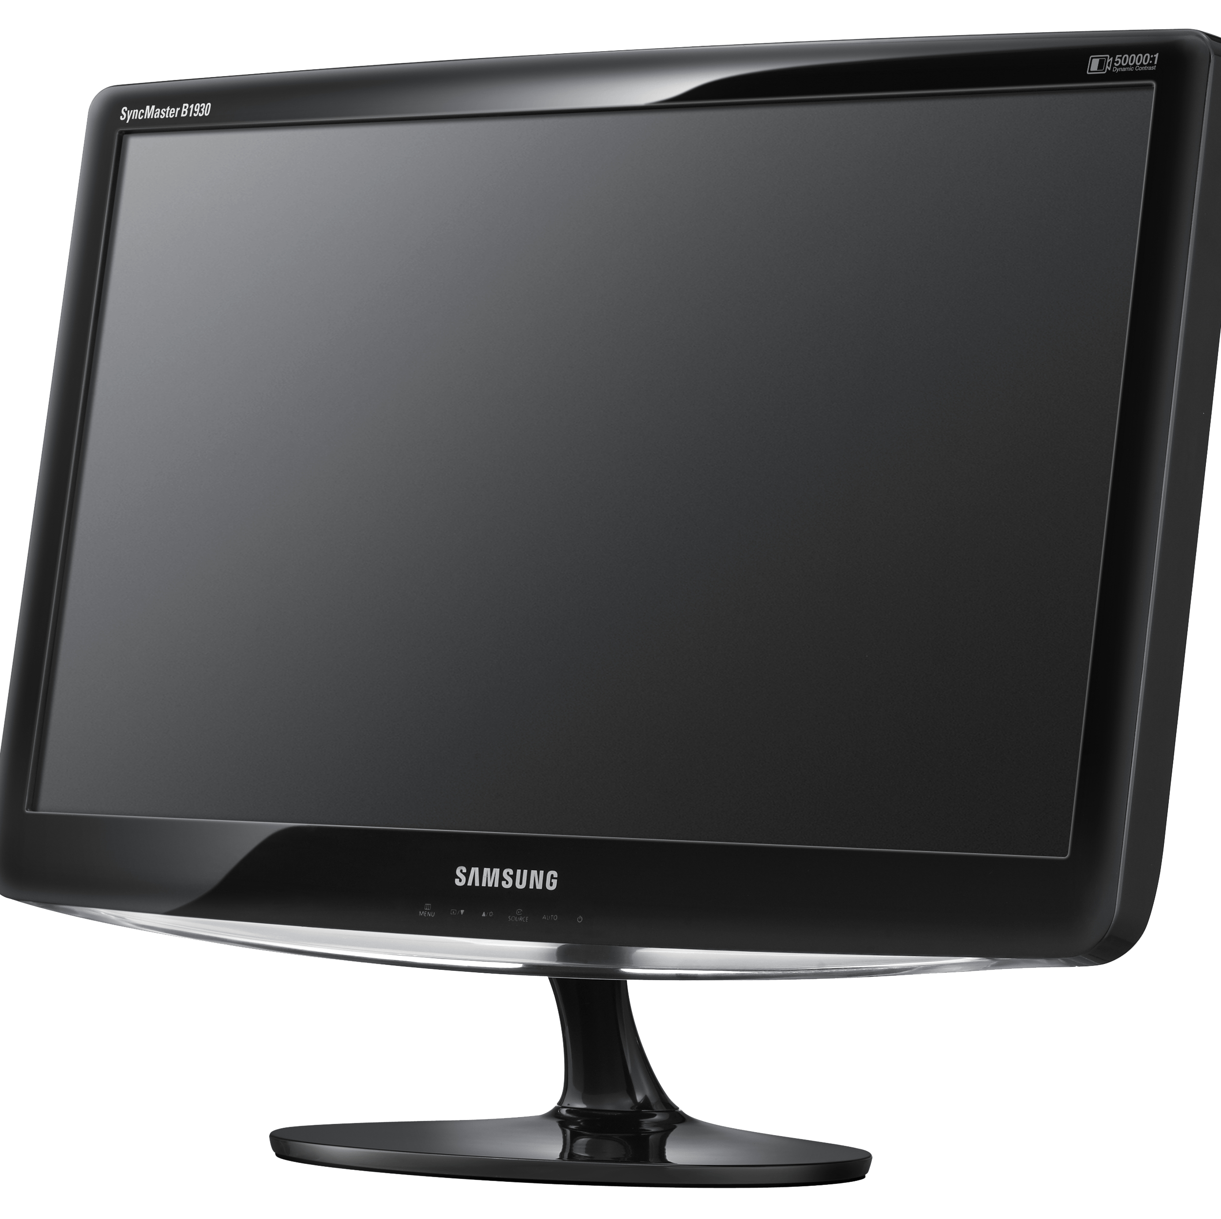
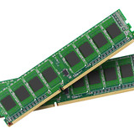

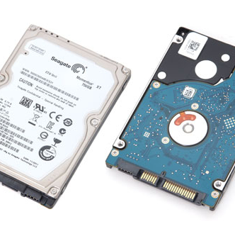

HARDWARE REQUIREMENTS
Intel Core i3 / AMD Ryzen 3
1366x768 resolution (Minimum)
4GB (Minimum) / 8GB (Recommended)
Standard input devices
Minimum Hardware Requirements
256GB HDD / 128GB SSD
Standard input devices
For basic functionality, the system can run on standard hardware with the following specifications:

Slide 7

“Conclusion”
The Dairy Management System is designed to simplify and automate the daily operations of a dairy business. The system helps in maintaining records of suppliers, customers, milk purchase, sales, and billing efficiently. By replacing the manual system, it reduces human errors, saves time, and improves overall productivity. The project demonstrates how software technology can make dairy management more organized, accurate, and user-friendly. In the future, the system can be enhanced with a graphical user interface, database integration, and online access to make it more powerful and suitable for real-world dairy industries.
This Photo by Unknown Author is licensed under CC BY-NC-ND

Slide 8
Thank you
Nitin kumar and Rashu malik
This Photo by Unknown Author is licensed under CC BY-NC

